Slide 1
Welcome
RACIAL JUSTICE FUND

Slide 2
AGENDA
About Trust for London
Racial and Economic Justice
Racial Justice Fund
Aims and Objectives
Eligibility
Funded partners round one
Timetable
Q&A

Slide 3
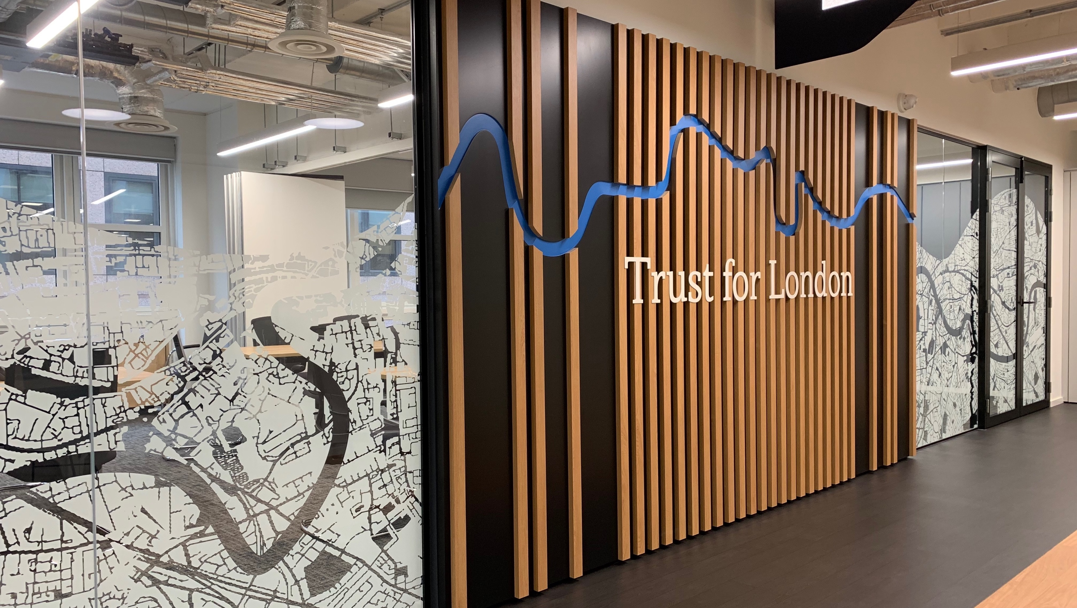
WHAT WE DO
Grants to organisations working to reduce poverty and inequality in London
Funding 300 organisations at any time
2018-2022 awarded 814 grants totalling £66 million
Currently reviewing our grants strategy with new programmes to be launched in 2024
Notes:
During 2022 we gave out over £13m, totalling 139 grants. £3.38m in social investment to support six growing social enterprises.
Continuation grants, DJF and RJF, social investment also available
New programmes open next year
Across our programmes – 45% of funding went to user led organisations; of which the largest % was to black, asian and racialised groups; analysis of 350 grants awarded under our current strategy 53% had an explicit aim to tackle racial inequity. Continued commitment as part of our next strategy so if not eligible or RJF isn’t quite the right fit, may be opportunities when we launch our new strategy next year;

Slide 4
Our core working areas
Trust for London
Across our programmes:
Housing
Migration
Decent living standards
Employment
Shared wealth
Activities:
Frontline advice work
Advocacy and campaigns
Building collective voice of people with first-hand experience
Research
Special initiatives:
Racial justice fund
Disability justice fund
Better temporary accommodation
Citizenship & integration initiative
Moving on up
Social investment:
Supporting pioneering projects and social enterprises.
Loans or equity.
www.trustforlondon.org.uk
Notes:
Until launch of new grants strategy in 2024, we are only open for continuation grants from existing grantholders; DJF and RJF.
Racial Justice Fund is a partnership with the City Bridge Trust focused on increasing economic empowerment in London’s Black and minoritised communities
Disability Justice Fund: is a partnership with the City Bridge Trust focused on giving Deaf and Disabled People’s Organisations a stronger voice and more power to demand the systematic change we need for a fair society.

Slide 5
RACIAL AND ECONOMIC JUSTICE
Praxis

Slide 6
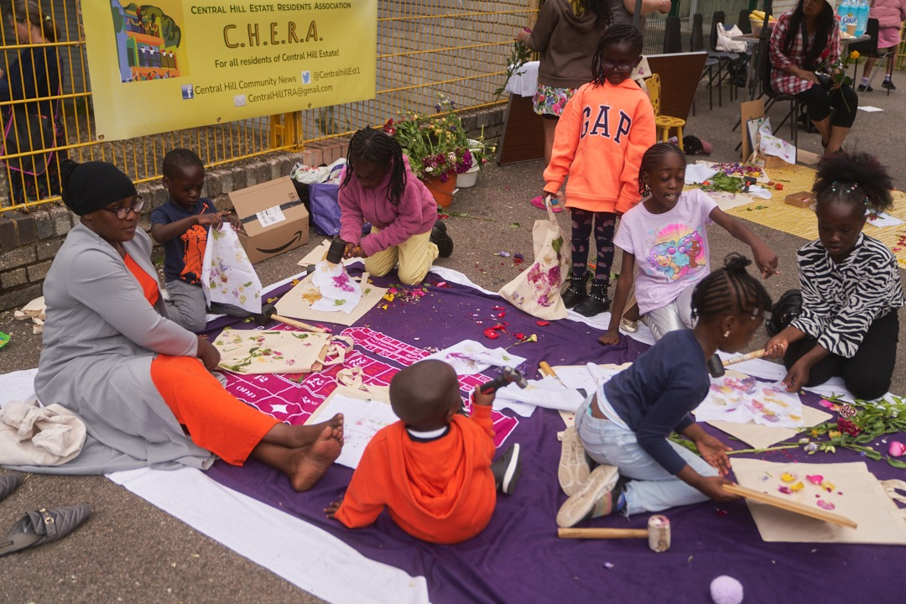
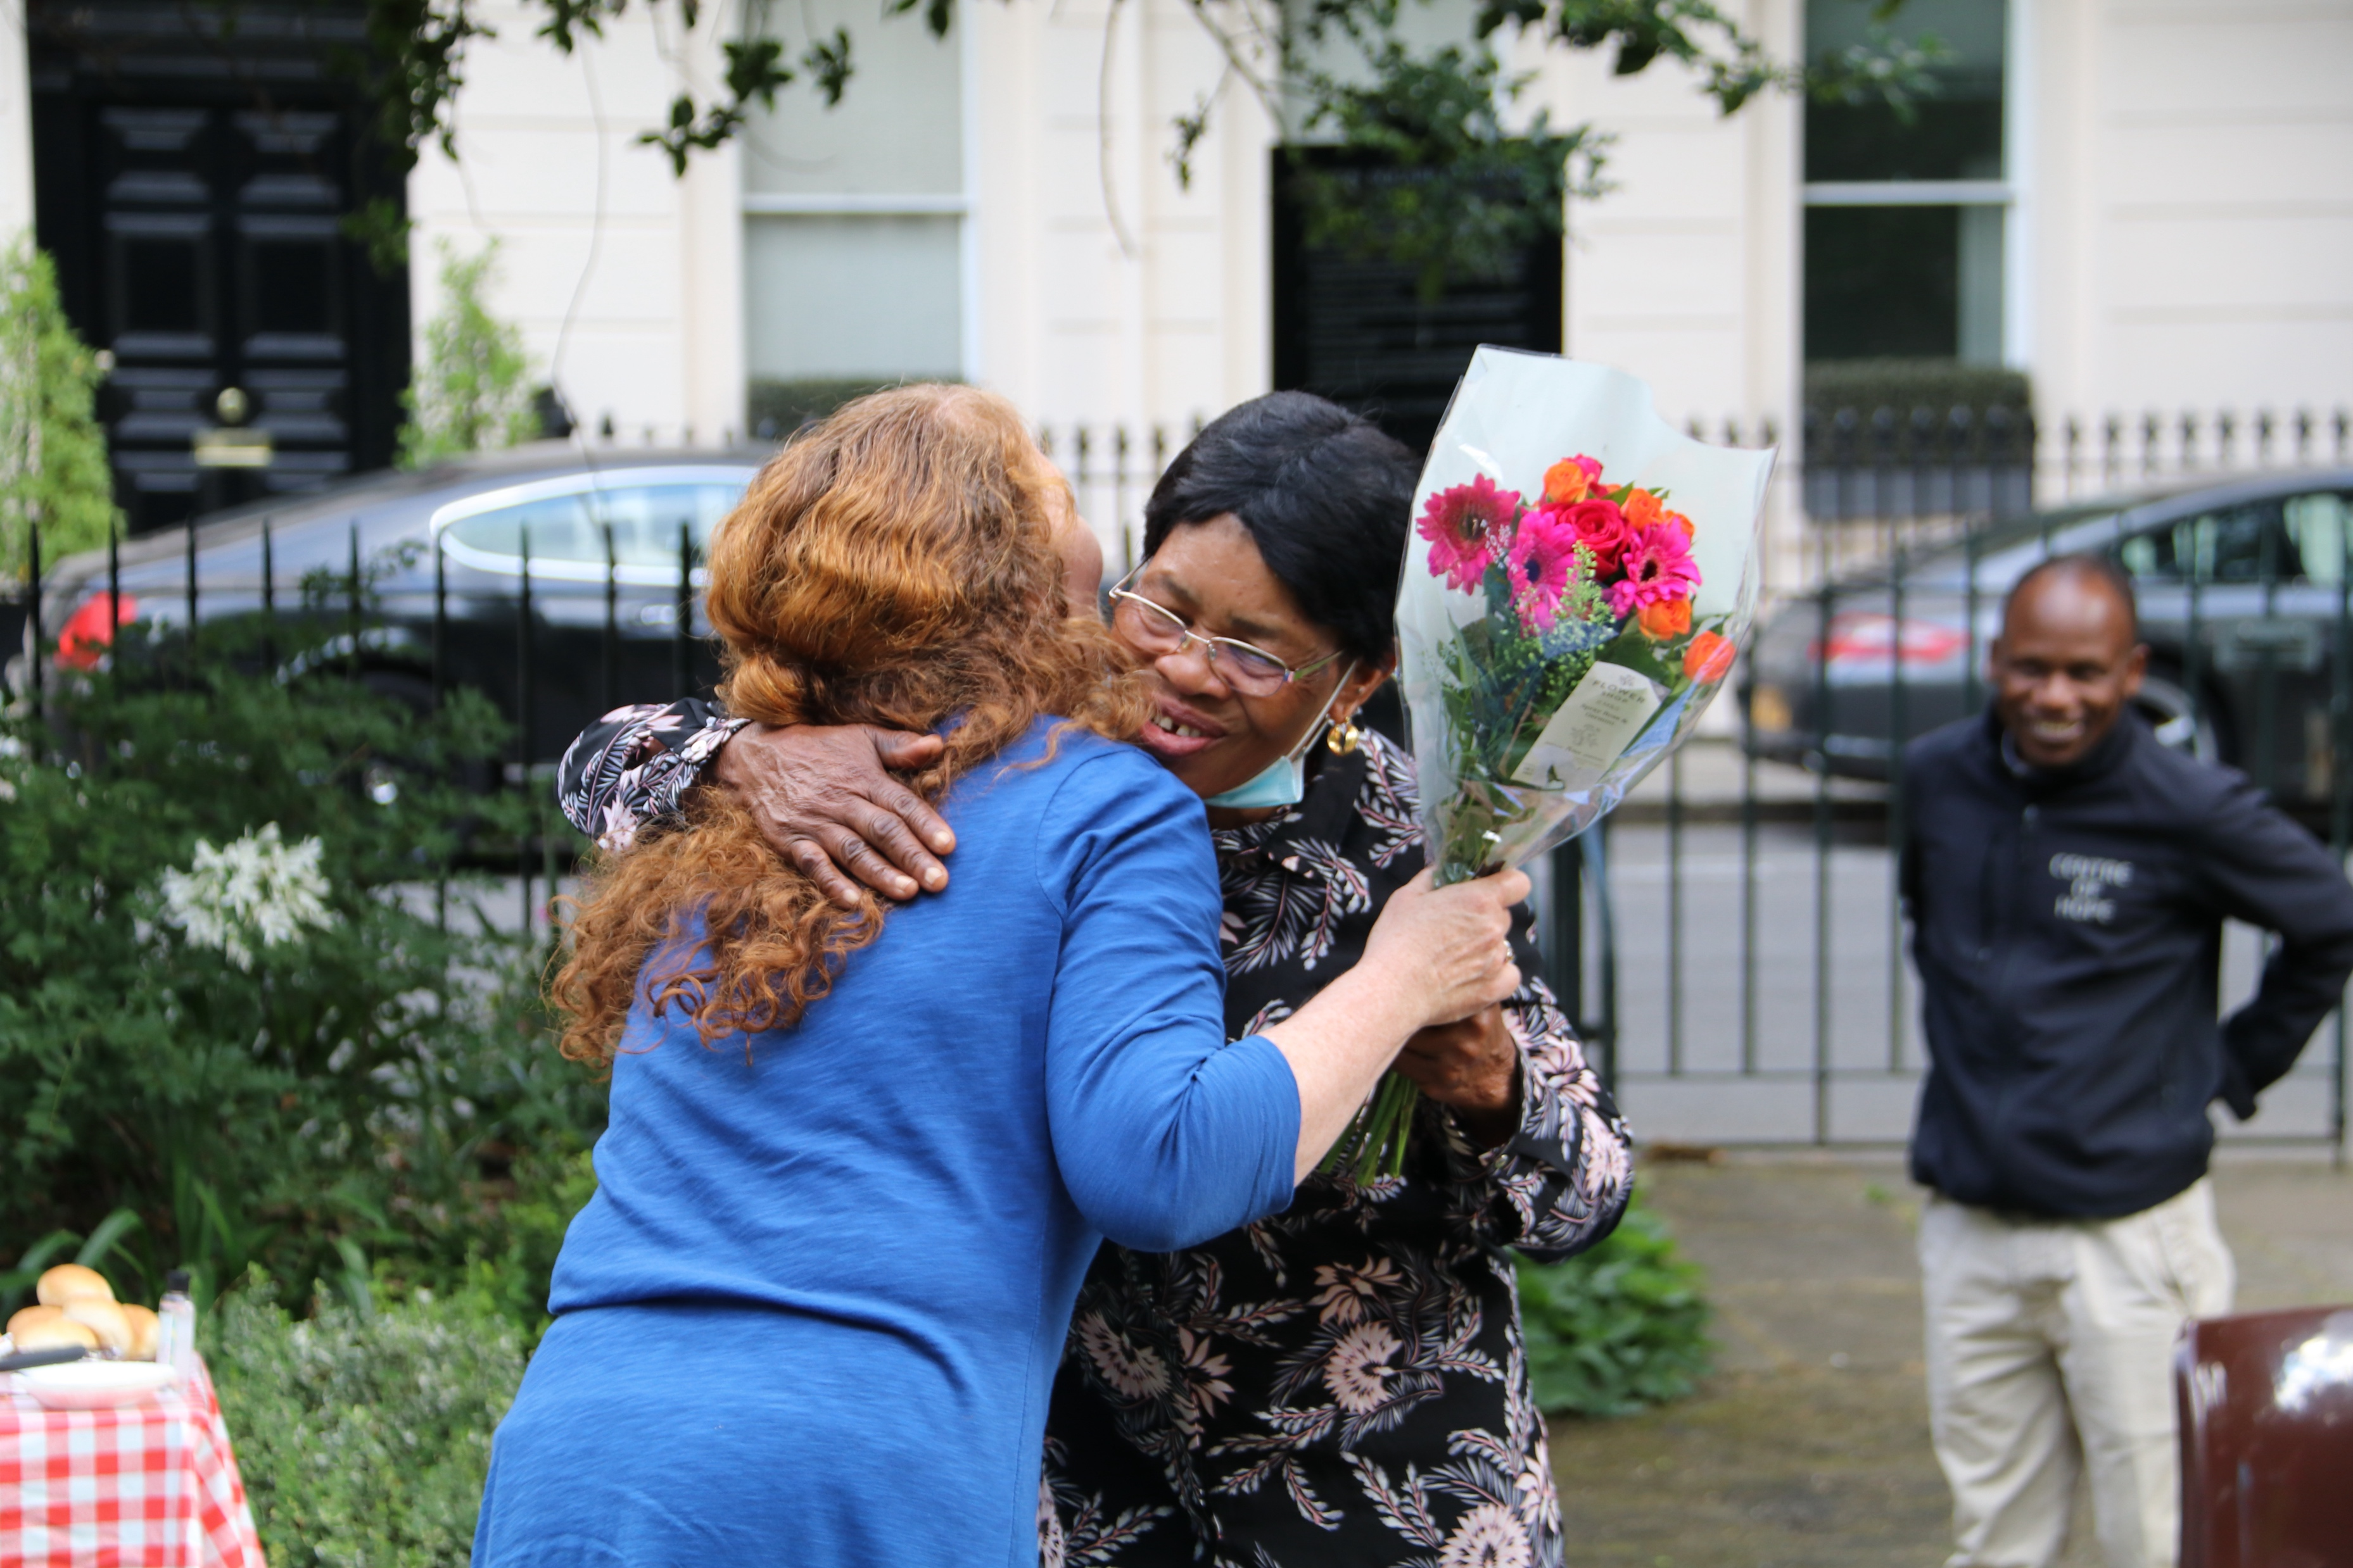
Compelling evidence about the links between race, racism and poverty
It’s clear: the evidence shows that households from Black and minoritised communities are nearly twice as likely to be in poverty than those from a White background.
In a city as diverse as London, we also need to recognise that some Black and minoritised groups do better than others. Data from the 2021 Census on London’s demographics, when mapped against the Indices of multiple deprivation (IMD) data, also shows the level of income inequality that exists between different ethnic groups in London.
Data from the Office of National Statistics (ONS) shows that compared with white British households, Black and minoritised people are more likely to live in households with lower levels of total net wealth and income, with fewer people in work.

Slide 7
Racial Justice Fund
Partnership with City Bridge Trust
£4 million to distribute
Designed with the help of people who have been working on racial justice for many years, alongside the lived and learned experience of staff and trustees of Trust for London
Launched in May 2022
Round 1: In December 2022, we made six grants to organisations totalling £840,000.
Round 2: £3.1 million available
https://www.trustforlondon.org.uk/funding/racial-justice/

Slide 8
Round 1: Racial Justice Fund
Expressions of interest:
125 received
11 shortlisted
11 invited to apply
Applications:
11 received
7 shortlisted
6 awarded

Slide 9
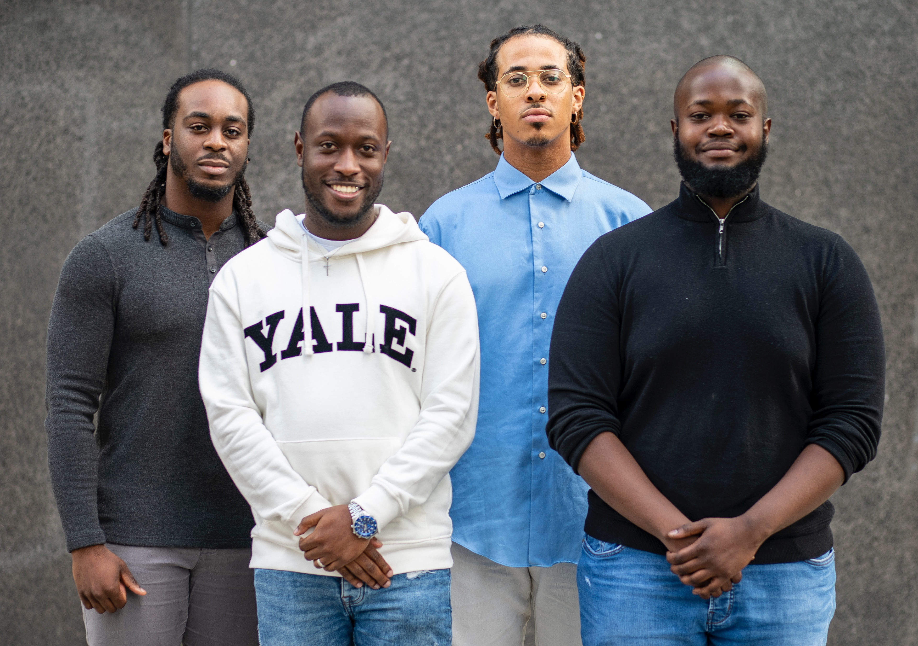
AIMS & OBJECTIVES

Slide 10
Our focus:
Tackling racial injustice by reducing poverty in London’s Black and minoritised communities
Our funding:
Campaigning and research to change policy and practice on the disparities across:
housing
employment
social welfare

Slide 11
Outcomes
Increase household income in Black and minoritised communities.
When we talk about income, we mean the amount of money households earn.
2. Increase the amount of household and community wealth in Black and minoritised communities.
When we talk about wealth, we mean the value of assets that households and communities hold.

Slide 12
We know that there are lots of different terms used to group together the communities we want to help with this fund.
We recognise that grouping communities and individuals under these umbrella terms, especially in a city as diverse as London, is flawed. We also recognise that, when it is necessary to create categories or groupings, people from these communities have different preferences.
For the racial justice fund, we’ve chosen to use ‘Black and minoritised’ communities. There is no science or theory behind us using this term, it’s just the term that we feel is respectful and will be familiar to a wide range of people.
Terminology:
‘Black and minoritised’

Slide 13
Who is eligible to apply?
Essential criteria:
Have at least three trustees or directors.
Be proposing work that takes place in London and/or benefiting Londoners.
Be undertaking charitable activities. You do not need to be a registered charity.
Companies and CICs must have at least one unpaid, independent director or an independent board (this could be an advisory board) with knowledge of and skills to scrutinise the organisation’s finances and governance.

Slide 14
Who is eligible to apply?
Prioritised criteria:
Have a significant track record of working on issues of racial justice and economic empowerment
Are majority-led by Black and minoritised communities (75% Trustees and/or 50% senior staff)
Take an intersectional approach
Applications where organisations are working in partnership to strengthen joint work on specific issues as well as smaller scale projects and research

Slide 15
A coalition of business leaders advocating for public policies that advance work, wages, and wealth in the Black community.
Implementation of a government retirement savings act / policy for low wage workers without retirement plans. ‘’Savings for the future Act’’ – A requirement for employers with ten employees or more to contribute £1 per hour worked to a portable retirement fund unless they have some alternative retirement plan.
Access to Capital – Policies that advocate for access and control of capital at scale and at competitive rates which has been a fundamental barrier to wealth in the Black community.
Community Wealth Building – Programs and policies around the reconfiguring of institutions and local economies based on greater democratic ownership, participation and control
Community Land Trust – Movement building and Organizing of collective, committed effort by black and minoritised residents and neighborhood associations to preserve affordable homeownership in their communities
Examples of activities we may fund

Slide 16
Advocacy and policy work affecting black and minoritised entrepreneurs of color.
Promotion of an inclusive national strategy of policy, support and resources to enable the growth of Black and minority owned businesses for the benefit of the overall UK economy.
Improving housing outcomes for Black, and minority ethnic groups and action to improve the condition of housing stock of all types (social housing, privately rented and owner occupied), as well as increasing prospects for homeownership
Increasing the role of Black and ethnic minority Housing Associations to provide targeted social housing that meets the specific needs of Black, Asian and minority ethnic groups
Reflecting the needs of Black, Asian and minority ethnic communities (including specific measures to address overcrowding) in development plans and local housing assessments.
Examples of activities we may fund

Slide 17
We cannot fund applications:
From individuals
From mainstream public services including schools and hospitals
From organisations which have fewer than three people on their governing body
For the promotion of religion
For general appeals
For work that has already taken place
From organisations holding significant free reserves. Reserves equating to up to nine months’ worth of expenditure is acceptable.
From organisations in serious financial deficits
For capital costs, including building and renovations (although small items of office equipment such as computers can be funded)
We cannot fund…
Service delivery – for example, mentoring, mental health support, wellbeing, employment support, sports programmes.

Slide 18
Examples of declined EOI’s from Round 1
Example 1:
Request: For funding for a Manager post and funding for more training facilitation/tutor time and textiles materials to provide mentoring and sewing training for low-income women from Bangladeshi backgrounds.
Feedback: This is focused on upskilling individuals and working with retailers to develop ethical supply chains - focus on work experience and employability
Example 2:
Request: For a financial education project for those aged 8 to 15 years to help young people develop a product or project that they can market and generate income from.
Feedback: Focused on individuals and did not consider addressing the barriers that lock whole communities out of financial wealth and security

Slide 19
Examples of declined EOI’s from Round 1
Example 3:
Request: For funding to develop capacity to continue delivering leadership development training and programmes for Black and minoritised staff.
Feedback: The focus on leadership and development training of black and minoritised staff in organisations and also the provision of EDI training to other organisations wasn't a fit with the programme. The link to the proposed activities and increasing economic empowerment in London's black and minoritised communities was unclear.
Example 4:
Request: For a development grant to support a consortium of 4 BME groups who work across older people, families, youth, disability, education, physical and mental health, gender.
Feedback: Whilst working in partnership is good, the activities proposed were unclear.

Slide 20
Grants
Use of funds: Core or project but will be restricted for the purpose of tackling racial justice and building economic empowerment.
Level of funding: Open to giving grants of up to 5 years. As a guide, in the first round we funded six organisations from a period from two to five years, with grants awarded between £50,000 to £248,000.
Development grants: We’re open to giving development grants to support organisations or consortiums to work up proposals and test approaches.
Shortlisting criteria: Read in full in the funding guidelines.
Decision making: The final decision on applications will be made by a group of Trust for London staff and trustees (including co-opted trustees), including people from Black and minoritised backgrounds

Slide 21
What are we trying to achieve?
People from black and minoritised communities have access to the power and resources needed to create economic wealth
Stronger alliances and movements of black and minoritised communities working effectively to influence and shift decision / policy makers
Increased income and economic wealth among black and minoritised communities
Reduced racial and economic inequalities caused by racialisation

Slide 22
FUNDED PARTNERS ROUND ONE

Slide 23
Meet the six organisations increasing economic empowerment among Black Londoners
Money A+E is a growing, Black-led social enterprise, providing accessible, independent, and effective money advice and education. Its mission is to support people facing money challenges to increase their financial resilience and have a healthy standard of living.
Money A+E in partnership with Rooted Finance is looking to deliver an ambitious programme of work over five years.
This partnership will focus on overcoming barriers facing Black and minoritised Londoners from accessing financial products and services, while also increasing representation within financial services jobs.
The Southall Community Alliance is as an umbrella organisation of more than 70 community groups supporting local groups. Over 90% of their users are from Black and minoritized ethnic communities.
The team will be using the grant to build an entrepreneurial attitude that helps black and minoritised groups understand how management and control of community assets provides significant wealth that can be used for the benefit of Southall’s minority communities.
It will help groups understand how building rental income and asset related projects can generate significant resources to be reinvested in anti-poverty community initiatives.

Slide 24
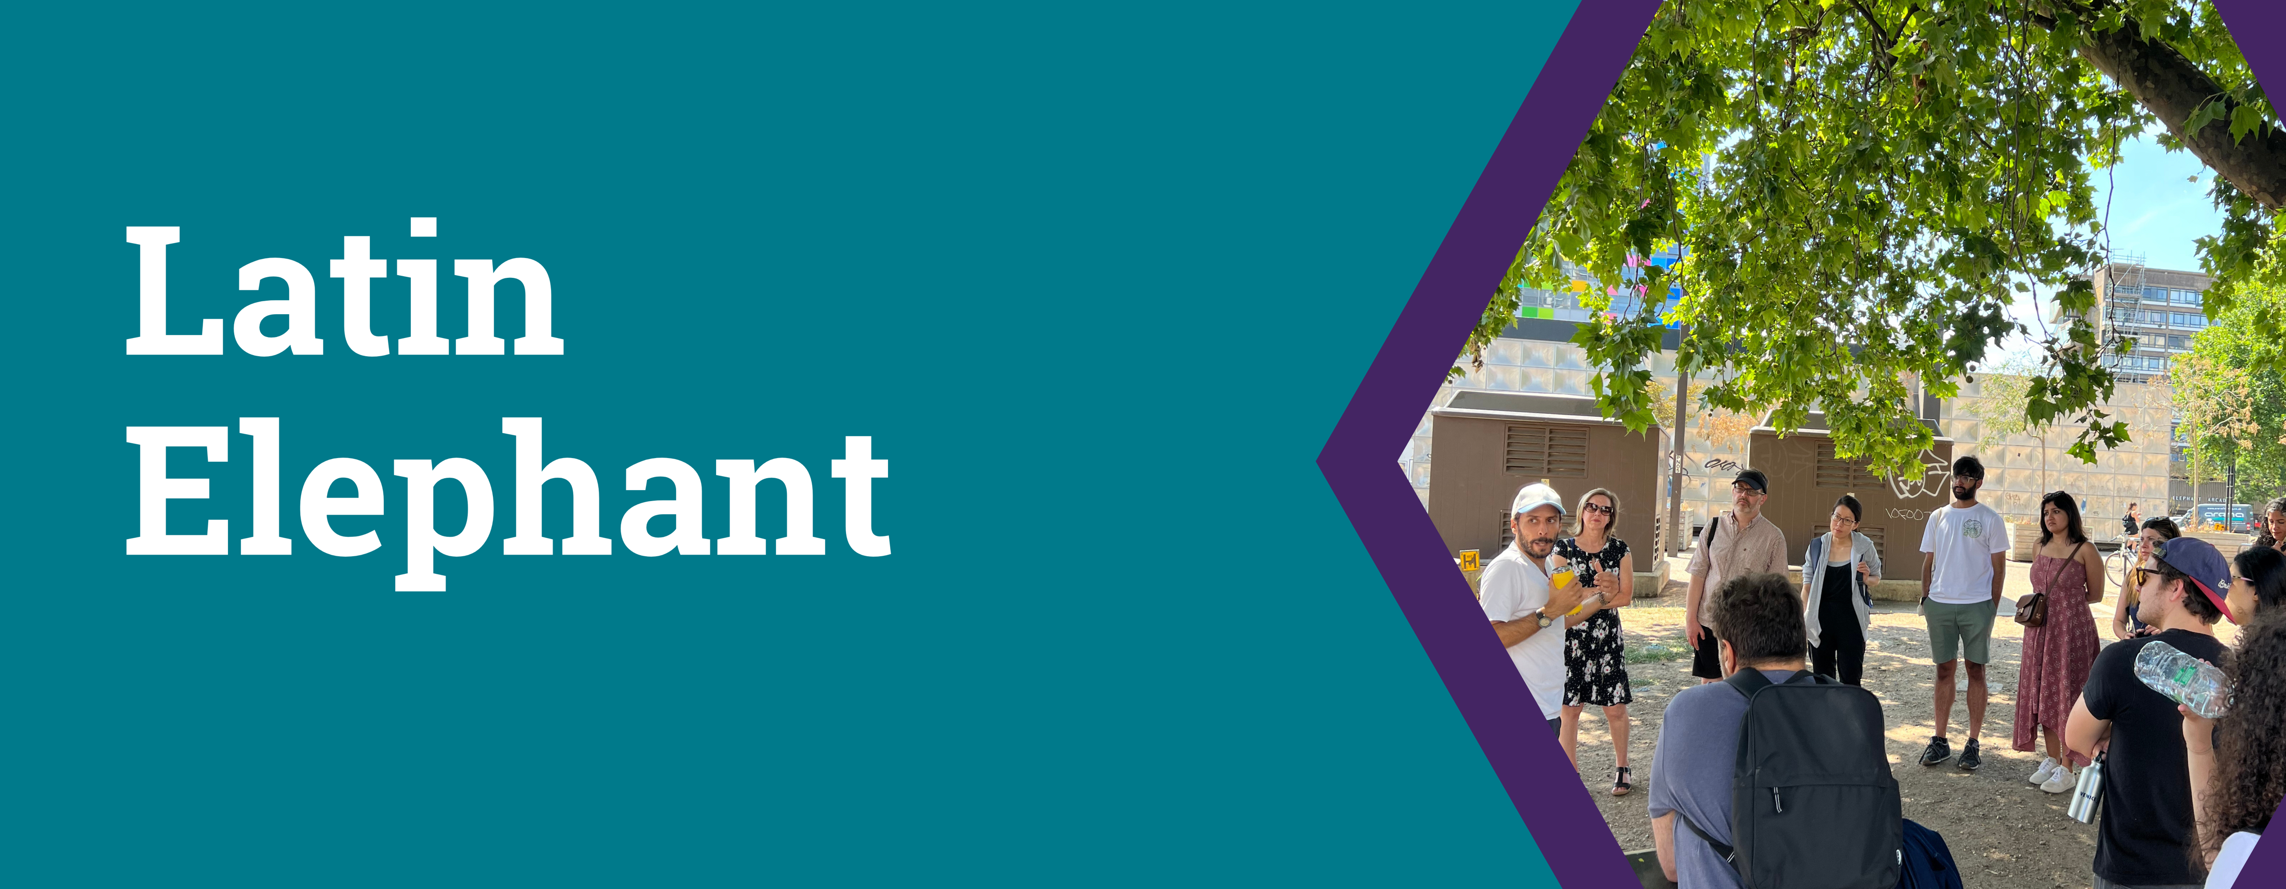
Meet the six organisations increasing economic empowerment among Black Londoners
For over 50 years Runnymede Trust has been at the forefront of discussions around racial equality. The charity produces research and analysis to challenge racial injustices and uses this to inform decision makers and the public of how we can build a fairer country.
We are funding Runnymede over two years to conduct research into how barriers to home ownership stifles economic growth for Black and minoritised communities in London.
They will use this research to help redress long standing systemic inequalities – by bringing forward policy ideas informed by people’s experiences and make significant in-roads in addressing the inaccessible cycle of inherited wealth that perpetuates racial inequality in the housing market.
Since 2014, Latin Elephant have been empowering Black and minoritised Londoners to engage in regeneration in their areas. The exclusion of Black and minoritised ethnic communities from planning processes can threaten areas of the city that have for decades been cultural and heritage bedrocks for local communities.
The funding is for a three-year project that will focus on building the power of migrant and racialised communities by creating a partnership with other migrant, minoritised community-led organisations in London campaigning against gentrification.
It aims to find new approaches to eradicating the ethnic bias in the planning system which ultimately decimates racialised and ethnic minoritised communities in London by displacing and demolishing the places that sustain their livelihoods and work.

Slide 25
Meet the six organisations increasing economic empowerment among Black Londoners
CommUNITY Barnet has supported small organisations in Barnet for over four decades. In response to the Black Lives Matter movement, it co-founded Barnet’s Black, Refugee and Minority Ethnic network.
We are funding CommUNITY Barnet over two years to research the barriers currently faced by local Black businesses. This work will inform a campaign to increase investment and support of Black social enterprise and entrepreneurs.
It will develop cross sector partnerships, to influence and shift the policy and operations of decision makers, particularly around the design, commissioning and delivery of services resulting in increased economic power and sustainability for Black businesses in Barnet.
The New Black Film Collective is a nationwide network of film producers, educators and programmers. Its aim is to become the UK's leading agency for Black film - providing support and development for Black people in a range of roles related to film.
We have provided a development grant to build the capacity of the organisation to research, advocate and build on an existing campaign by the NASUWT (Teacher’s Union).
The campaign is urging the government and employers to close the discriminatory gap in pay and career progression between Black teachers and their White colleagues through a Better Deal for Teachers.

Slide 26
Timetable
Tuesday 5 September 2023 | Launch of fund and opening of EOIs
Tuesday 19 and Thursday 21 September 2023
Monday 25 September 2023 Tuesday 26 September 2023 Tuesday 3 October 2023 Wednesday 4 October 2023 Thursday 5 October 2023 | Bookable 1-2-1’S with grants managers 30 mins each Link will be available on our website soon.
Monday 16 October 5pm | STAGE ONE - deadline for submission of EOI’s
Monday 20 November 2023 | STAGE TWO - successful EOI’s invited to apply
Friday 22 December 2023 1pm | Deadline for submission of STAGE TWO applications
Monday 5 February 2024 | STAGE TWO - successful applicants invited to assessment
Monday 19 February 2024 – Friday 8 March 2024 | Assessment meetings
Week of Monday 25 March 2024 | Committee review
1st Week of April 2024 | Grants Awarded

Slide 27
Next steps:
Read the funding guidelines
Register for a 121 call with a Grants Manager to discuss eligibility and alignment
Submit your Expression of Interest
For more information please get in touch
Ugo Ikokwu, ugo@trustforlondon.org.uk
Tripta Bains, tripta@trustforlondon.org.uk
Rebecca Roberts, rebecca@trustforlondon.org.uk

